Slide 1
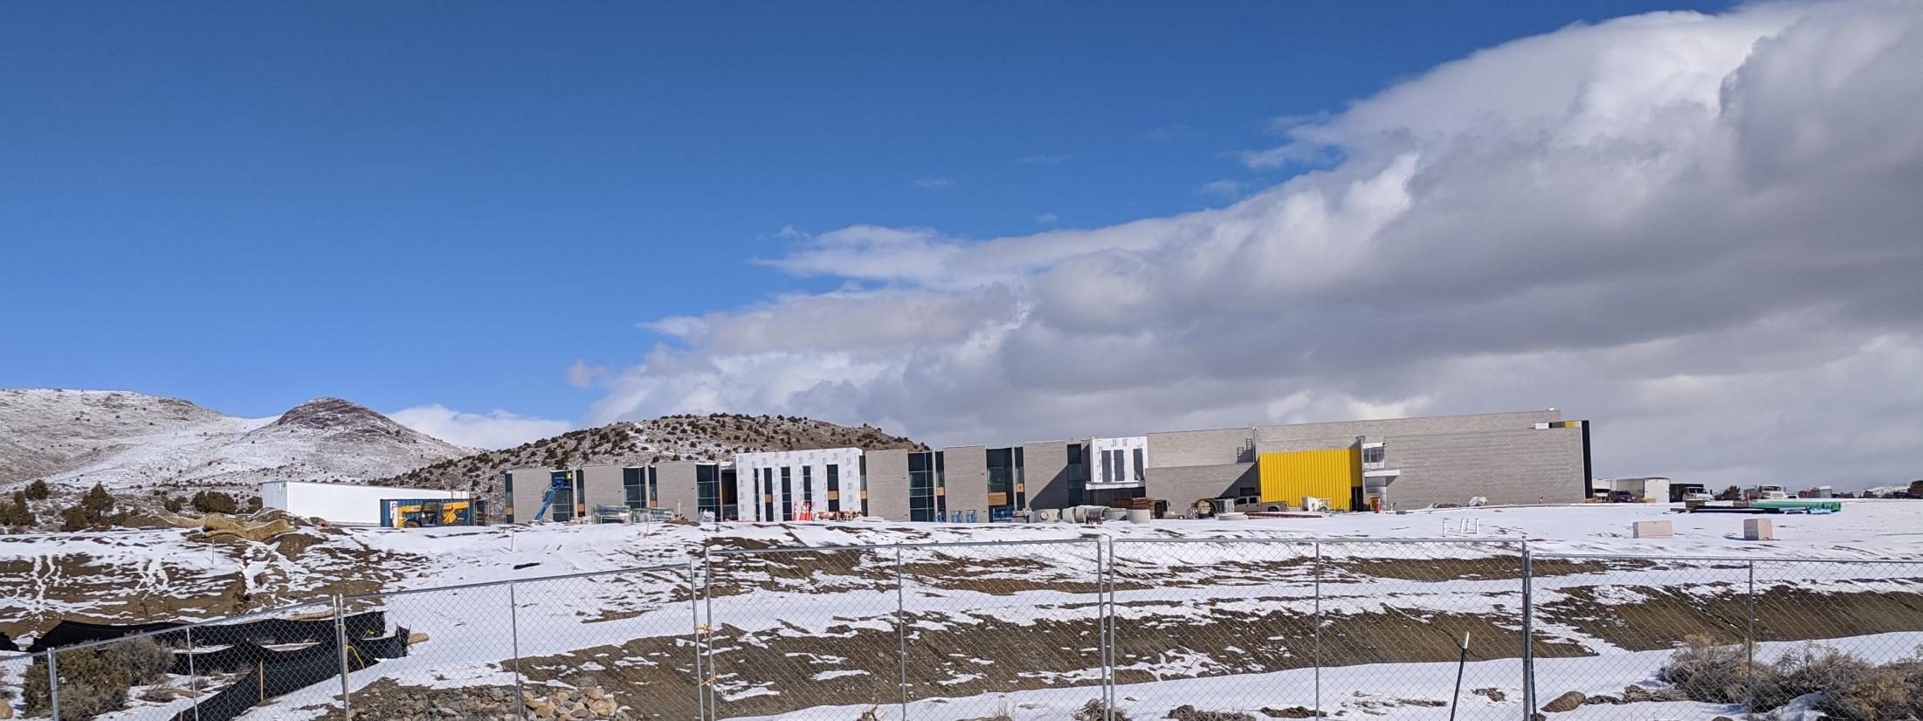
Case Number WADMIN19-0003
Desert Skies Middle School Sign
Washoe County Board of Adjustment
April 4, 2019

Slide 2
Overview
Desert Skies Middle School is being built at 7550 Donatello Dr. for Washoe County School District.
Building Mounted Sign proposed, in keeping with Washoe County Signage Theme

Slide 3
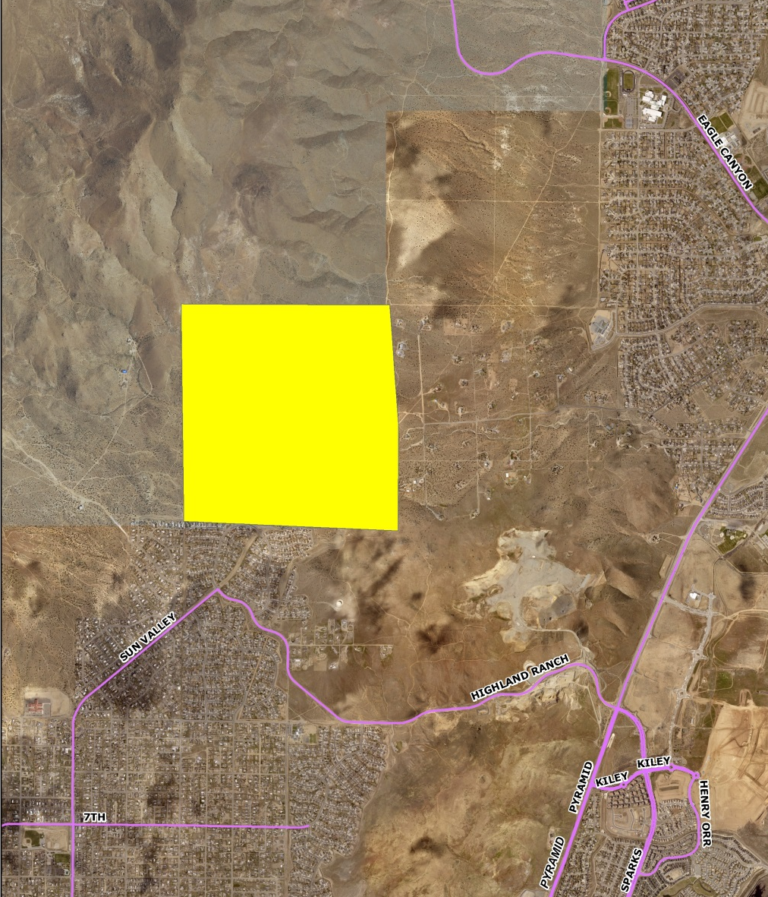
Overview

Slide 4
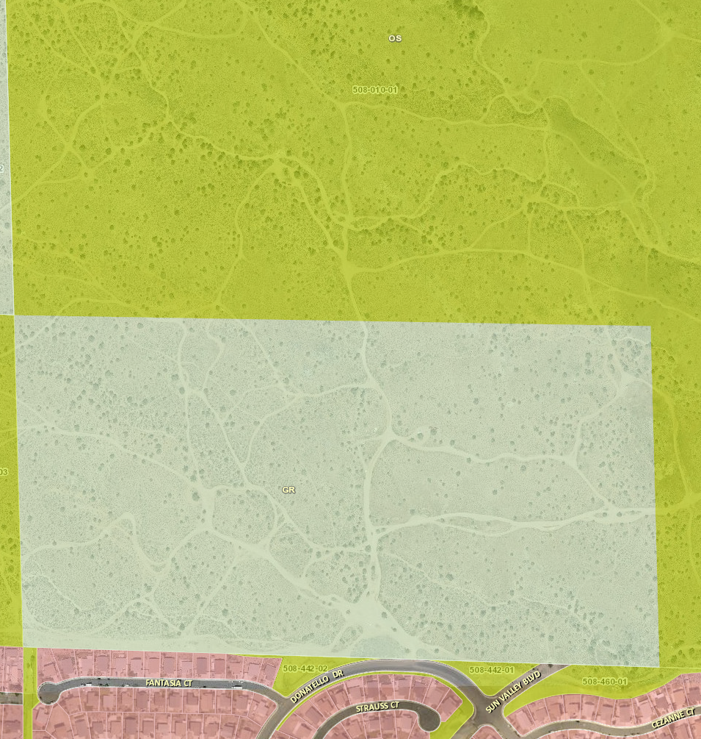
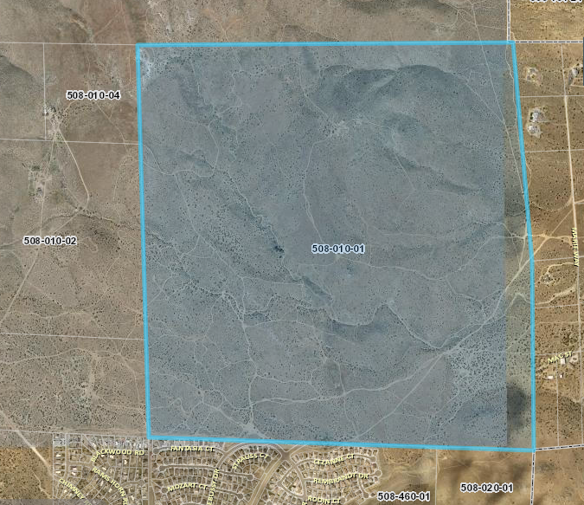
Overview

Slide 5
Overview
40 acre parcel owned by the United States of America
Building located in General Rural zone (GR) and Spanish Springs Area Plan
Sun Valley CAB

Slide 6
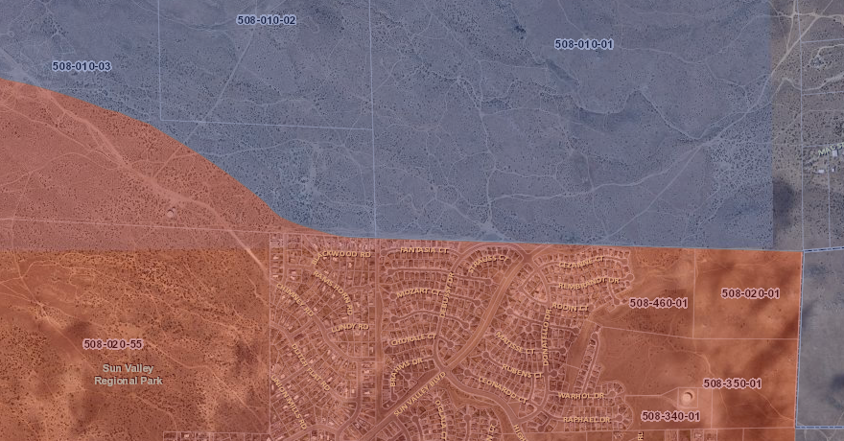
Overview
Spanish Springs Area Plan
Sun Valley Area Plan

Slide 7
Overview
Table 110.505.15.1 allows up to 120 square feet for Civic uses in the GR zone. Larger with an Administrative Permit.
A building mounted sign greater than 120 square foot in size, ±224 square feet in size.
Building frontage of ±753 square feet.

Slide 8
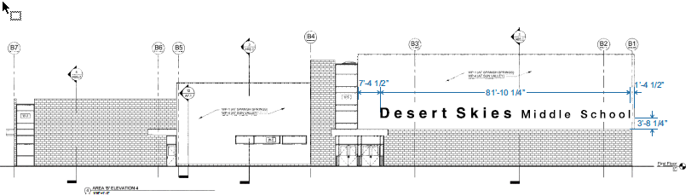
Request

Slide 9

Overview
Proposed Frontage
Picture taken immediately in front of nearest house, ±510 feet

Slide 10
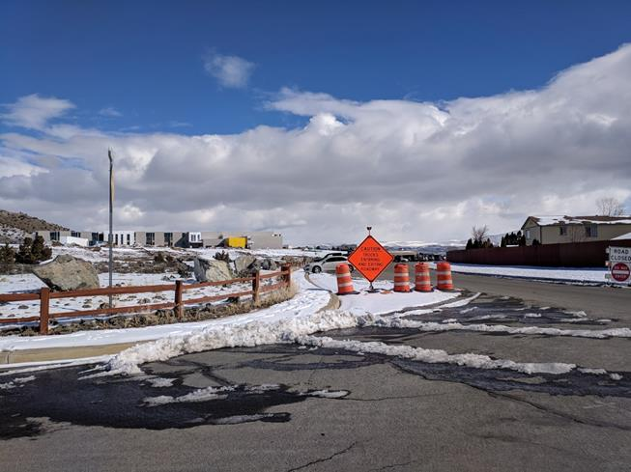
Overview
Last clear view from the west. ±1000 feet

Slide 11
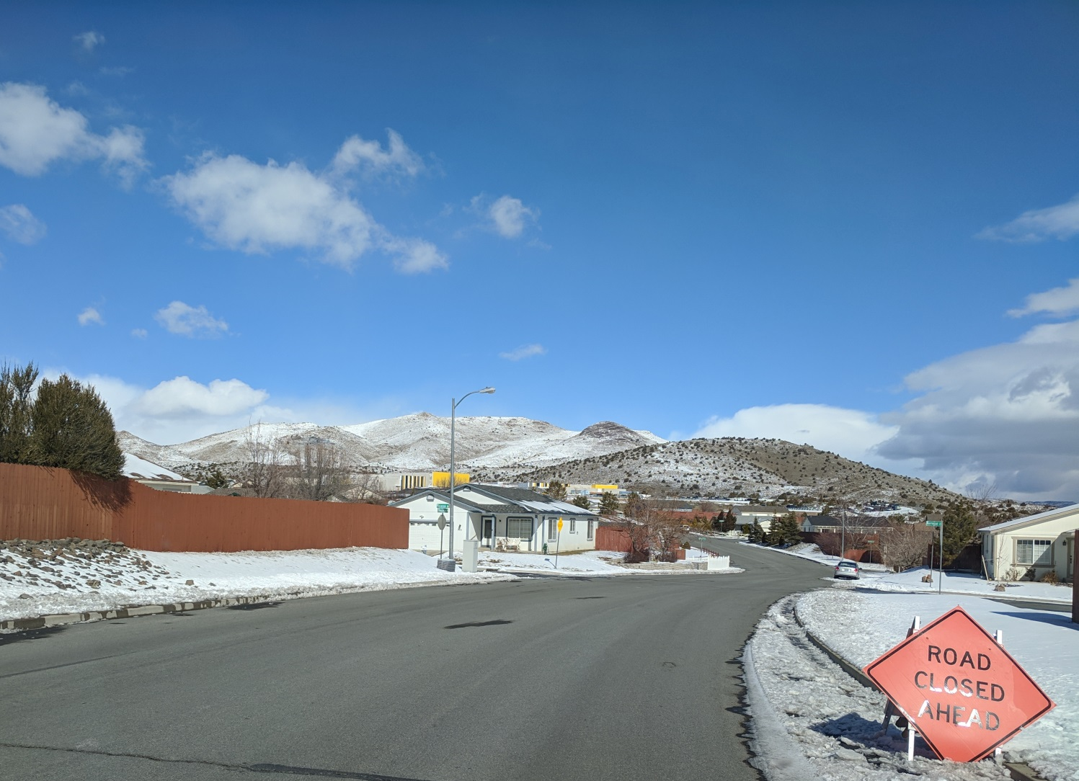
Overview
Last clear view from the east. ±1600 feet

Slide 12
Overview
Washoe County Schools Theme For School Signage

Slide 13
Public Notice & CAB
Notice was sent to 178 affected property owners within 500 feet of property boundaries.
Sun Valley CAB did not meet during the review period, a worksheet was sent, no comments returned.

Slide 14
Reviewing Agencies
Washoe County Community Service
  Planning and Building Division
  Engineering and Capital Projects
Regional Transportation Commission
Truckee Meadows Fire Protection District
Nevada Department of Transportation
Sun Valley General Improvement District
City of Sparks Community Services
Washoe-Storey Conservation District

Slide 15
Recommendation
Approve with Conditions
Conditions of Approval are in Exhibit A of each Commissioner’s case packet

Slide 16
Possible Motion
Motion
I move that, after giving reasoned consideration to the information contained in the staff report and information received during the public hearing, the Board of Adjustment approve Administrative Permit Case Number WADMIN19-0003 for Desert Skies Middle School Sign, having made all four findings in accordance with Washoe County Development Code Section 110.808.25.

Slide 17
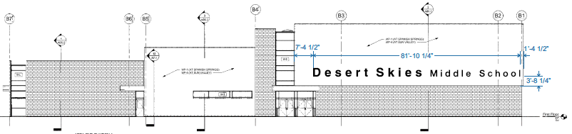
Questions

